Slide 1
Data Science Learning Roadmap for 2022
By, Knowledge Shelf

Slide 2
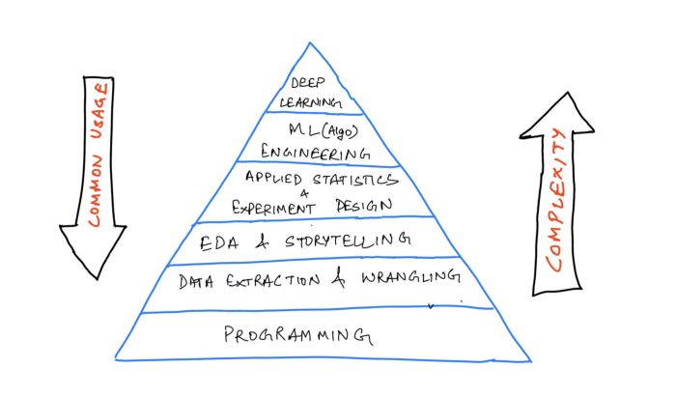
Soo What’s the Today’s Agenda
How to become Data Science master in 2021

Slide 3
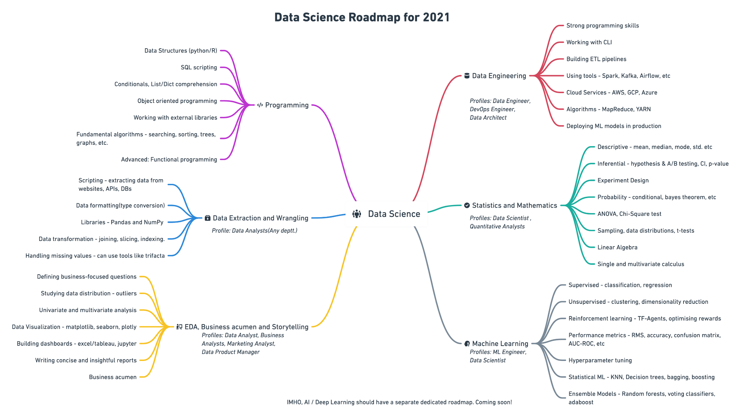
How to become Data Science master in 2021

Slide 4
1. Programming or Software Engineering
Common data structures(data types, lists, dictionaries, sets, tuples), writing functions, logic, control flow, searching and sorting algorithms, object-oriented programming, and working with external libraries.
SQL scripting: Querying databases using joins, aggregations, and subqueries
Comfortable with using the Terminal, version control in Git, and using GitHub

Slide 5
Resources
learnpython.org [free]— a free resource for beginners. It covers all the basic programming topics from scratch. You get an interactive shell to practice those topics side-by-side.
Kaggle [free]— a free and interactive guide to learning python. It is a short tutorial covering all the important topics for data science.
Python Course by freecodecamp on YouTube[free] — This is a 5-hour course that you can follow to practice the basic concepts.
Intermediate python [free]— Another free course by Patrick featured on freecodecamp.org.
Coursera Python for Everybody Specialization[fee] — this is a specialization encompassing beginner-level concepts, python data structures, data collection from the web, and using databases with python.
Intro to SQL and Advanced SQL on Kaggle.
Datacamp also offers many courses on SQL.

Slide 6
2. Data collection and Wrangling(Cleaning)
A significant part of the data science work is centered around finding apt data that can help you solve your problem. You can collect data from different legitimate sources — scraping(if the website allows), APIs, Databases, publicly available repositories.

Slide 7
Resources
Data Manipulation using pandas[fee] —an interactive course from datacamp that can quickly get you started with manipulating data using pandas. Learn to add transformations, aggregations, subsetting, and indexing dataframes.
Kaggle pandas tutorial[free] — A short and concise hands-on tutorial that will walk you through commonly used data manipulation skills.
Data Cleaning course by Kaggle.
freecodecamp course on learning Numpy, pandas, matplotlib, and seaborn[free].
Coursera course on Introduction to Data Science in Python[fee] — This is the first course in the Applied Data Science with Python Specialization.

Slide 8
3. EDA, Business acumen and Storytelling
Exploratory data analysis — defining questions, handling missing values, outliers, formatting, filtering, univariate and multivariate analysis.
Data visualization — plotting data using libraries like matplotlib, seaborn, and plotly. Knowledge to choose the right chart to communicate the findings from the data.
Developing dashboards — a good percent of analysts only use Excel or a specialized tool like Power BI and Tableau to build dashboards that summarise/aggregate data to help the management in making decisions.
Business acumen: Work on asking the right questions to answer, ones that actually target the business metrics. Practice writing clear and concise reports, blogs, and presentations.

Slide 9
Resources
Career track on Data Analysis — by datacamp. A good list of interactive courses that you can refer to along with real-world case studies that they use while teaching. But do work on your own projects after going through the specialization.
Data Analysis with Python — by IBM on Coursera. The course covers wrangling, exploratory analysis, and simple model development using python.
Data Visualization — by Kaggle. Another interactive course that lets you practice all the commonly used plots.
Data Visualization in Spreadsheets, Excel, Tableau, Power BI — pick anyone.
Build product sense and business acumen with these books: Measure what matters, Decode and conquer, Cracking the PM interview.

Slide 10
4. Data Engineering
Data engineering underpins the R&D teams by making clean data accessible to research engineers and scientists at big data-driven firms. It is a field in itself and you may decide to skip this part if you want to focus on just the statistical algorithm side of the problems.

Slide 11
Resources
[Book]Machine Learning Engineering by Andriy Burkov — this is a book that captures the real scenario of deploying/monitoring a model in a production environment.
Data Engineering Nanodegree by Udacity — as far as a compiled list of resources is concerned, I have not come across a better-structured course on data engineering that would cover all the major concepts from scratch.
Introduction to Data Engineering — By datacamp. A good resource to get started with building ETL pipelines with a host of tools.
Data Engineering, Big Data, and Machine Learning on GCP Specialization — You can complete this specialization offered by Google on Coursera that walks you through all the major APIs and services offered by GCP to build a complete data solution.

Slide 12
5. Applied statistics and mathematics
Descriptive Statistics — to be able to summarise the data is powerful but not always. Learn about estimates of location(mean, median, mode, weighted statistics, trimmed statistics), and variability to describe the data.
Inferential statistics — designing hypothesis tests, A/B tests, defining business metrics, analyzing the collected data and experiment results using confidence interval, p-value, and alpha values.
Linear Algebra, Single and multi-variate calculus to understand loss functions, gradient, and optimizers in machine learning.

Slide 13
Resources
[Book]Practical statistics for data science(highly recommend) — A thorough guide on all the important statistical methods along with clean and concise applications/examples.
[Book]Naked Statistics — a non-technical but detailed guide to understanding the impact of statistics on our routine events, sports, recommendation systems, and many more instances.
Statistical thinking in Python — a foundation course to help you start thinking statistically. There is a second part to this course as well.
Intro to Descriptive Statistics— offered by Udacity. Consists of video lectures explaining widely used measures of location and variability(standard deviation, variance, median absolute deviation).
Inferential Statistics, Udacity — the course consists of video lectures that educate you on drawing conclusions from data that might not be immediately obvious. It focuses on developing hypotheses and use common tests such as t-tests, ANOVA, and regression.

Slide 14
6. Machine Learning / AI
Supervised Learning — includes regression and classification problems. Study simple linear regression, multiple regression, polynomial regression, naive Bayes, logistic regression, KNNs, tree models, ensemble models. Learn about evaluation metrics.
Unsupervised Learning — Clustering and dimensionality reduction are the two widely used applications of unsupervised learning. Dive deep into PCA, K-means clustering, hierarchical clustering, and gaussian mixtures.
Reinforcement learning(can skip*) — helps you build self-rewarding systems. Learn to optimize rewards, using the TF-Agents library, creating Deep Q-networks, etc.

Slide 15
Resources
[book]Hands-On Machine Learning with Scikit-Learn, Keras, and TensorFlow, 2nd Edition — one of my all-time favorite books on machine learning. Doesn’t only cover the theoretical mathematical derivations but also showcases the implementation of algorithms through examples. You should solve the exercises given at the end of each chapter.
Machine Learning Course by Andrew Ng — the go-to course for anyone trying to learn machine learning. Hands down!
Introduction to Machine Learning — Interactive course by Kaggle.
Intro to Game AI and Reinforcement Learning — another interactive course on Kaggle on reinforcement learning.
Supervised learning with Python — datacamp offers a multitude of courses on machine learning that one can follow. All of them are 4 hours long and can help you get a decent understanding of the application of ML.

Slide 16
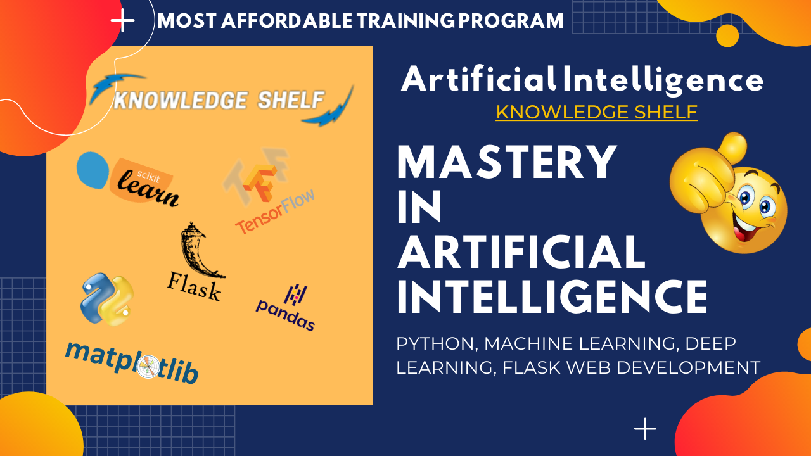
Data Science Weekend & Weekdays Batch's

Slide 17

Like Share & Subscribe
By, Knowledge Shelf

